Slide 1



AIRLINE MANAGEMENT SYSTEM
TEAM ID : DS_14
TEAM MEMBERS : Karthik R [23ITR080]
Mounith D [23ITR103]
Mownisha A [23ITR104]
JAIHARI D (19ITR028)

Slide 2

An airline reservation system needs to be developed to manage and organize flight records effectively.
The system must store flight details, including flight number, airline name, source, and destination.
Administrators, such as station masters, will interact with the system to manage these records, including adding, searching, and deleting flights.
Additionally, the system must handle passenger reservations, waitlists, and fine calculations.

Slide 3
Objectives
To implement a flight record system using a hash table for storage, with functions for adding, removing, and searching flights, alongside sorting and reservation management. Provide an admin interface for efficient interaction, allowing only deletion of flights.
3

Slide 4
Software Tools used
Frame work : AWT
Editor : Eclipse IDE
Data Structures used : Array, Linked list, Queue, Hash Table, Binary Tree
Algorithms Used : Sorting
4

Slide 5
Implementation Details
1. Use a hash table to store flight records (flight number, airline name, source, destination).
2. Implement functions to add, remove, and search flights by number and name.
3. Use sorting algorithms like merge sort to arrange flights alphabetically.
4. Manage reservations with a queue and handle waitlists using a priority queue.
5. Include functionality to calculate fines for cancellations and changes.
6. Create a user interface for the admin (Station Master) to manage flights and reservations.
5

Slide 6
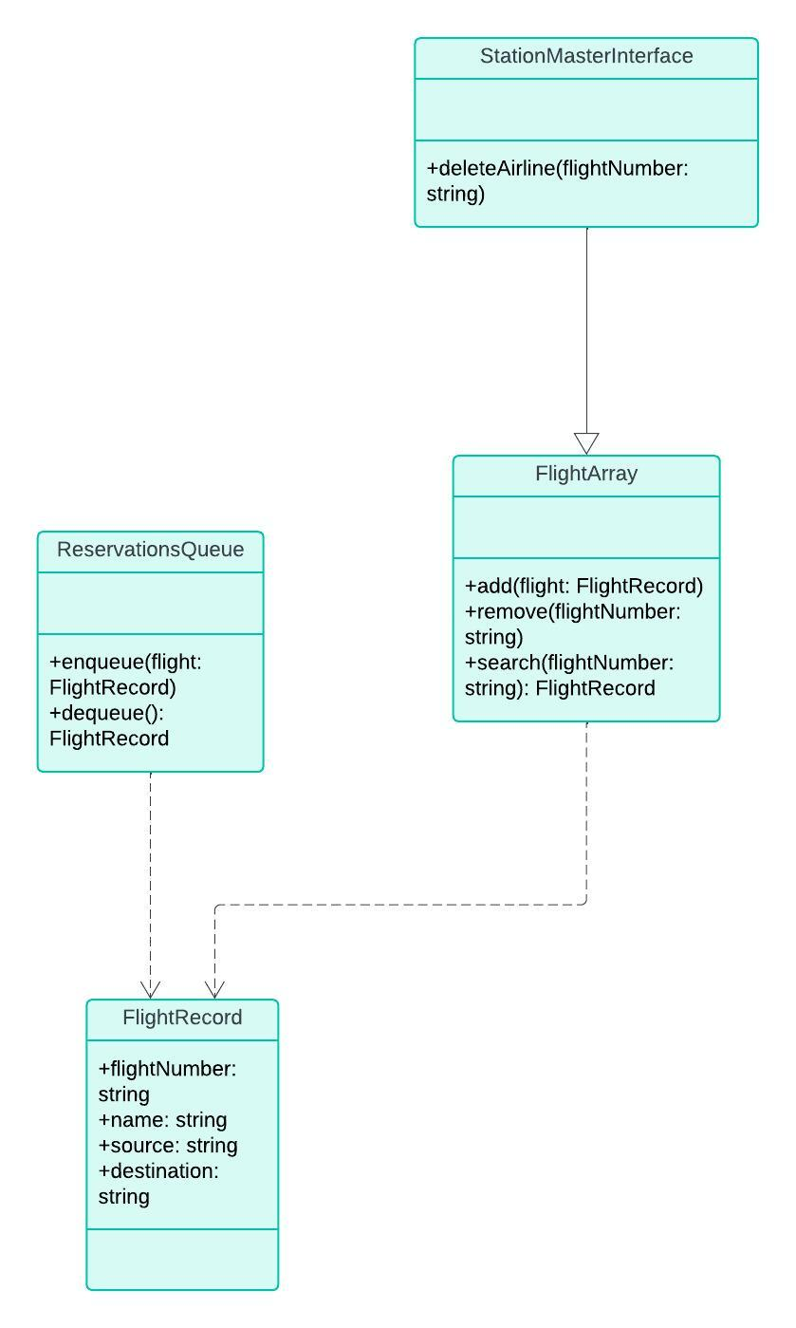
CLASS DIAGRAM

Slide 7
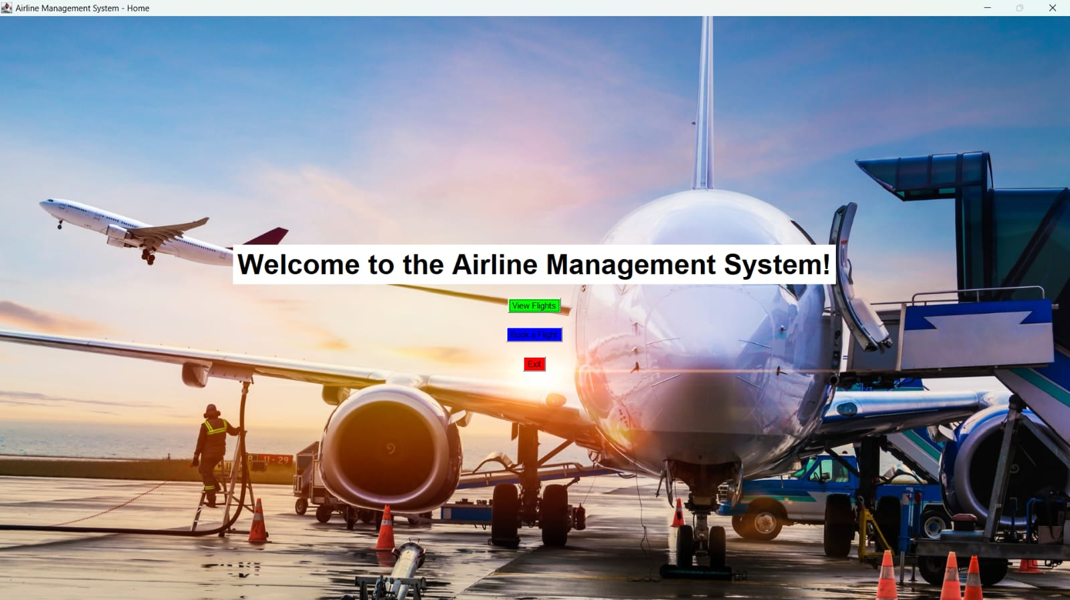
Module 1(Home Page)
package airline; import java.awt.*; import java.awt.event.*; public class Home extends Frame implements ActionListener { private static final long serialVersionUID = 1L; Button viewFlightsButton, bookFlightButton, exitButton; Image backgroundImage; Label welcomeLabel; public Home() { // Load the background image backgroundImage = Toolkit.getDefaultToolkit().getImage("C:\\Users\\Mounith\\Desktop\\study\\Project\\airline.png");

Slide 8
setTitle("Airline Management System - Home"); setExtendedState(Frame.MAXIMIZED_BOTH); // Maximize the window setResizable(false); // Optional: Prevent resizing setLayout(new GridBagLayout()); GridBagConstraints gbc = new GridBagConstraints(); gbc.insets = new Insets(10, 10, 10, 10); // Initialize and add welcome label welcomeLabel = new Label("Welcome to the Airline Management System!", Label.CENTER); welcomeLabel.setFont(new Font("Times New Roman", Font.BOLD, 40)); //welcomeLabel.setBackground(Color.GREEN); //welcomeLabel.setForeground(Color.BLACK); gbc.gridwidth = 1; gbc.gridy = 0; gbc.gridx = 0; add(welcomeLabel, gbc); // Add buttons gbc.gridwidth = 1; gbc.gridy = 1; viewFlightsButton = new Button("View Flights"); viewFlightsButton.setBackground(Color.GREEN); viewFlightsButton.setForeground(Color.BLACK); add(viewFlightsButton, gbc); gbc.gridy = 2; bookFlightButton = new Button("Book a Flight"); bookFlightButton.setBackground(Color.BLUE); bookFlightButton.setForeground(Color.BLACK); add(bookFlightButton, gbc);
gbc.gridy = 3; exitButton = new Button("Exit"); exitButton.setBackground(Color.RED); exitButton.setForeground(Color.BLACK); add(exitButton, gbc); // Add action listeners viewFlightsButton.addActionListener(this); bookFlightButton.addActionListener(this); exitButton.addActionListener(this); addWindowListener(new WindowAdapter() { public void windowClosing(WindowEvent e) { System.exit(0); // Ensure application exits } }); setVisible(true); } public void paint(Graphics g) { super.paint(g); g.drawImage(backgroundImage, 0, 0, getWidth(), getHeight(), this); } public static void main(String[] args) { new Home(); // Start the application } }

Slide 9
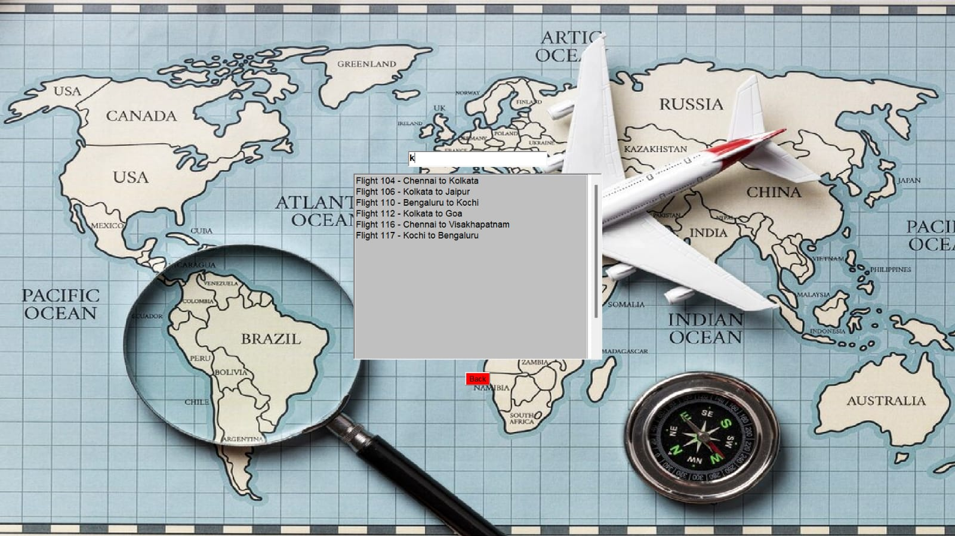
Module 2(Flight List)

Slide 10
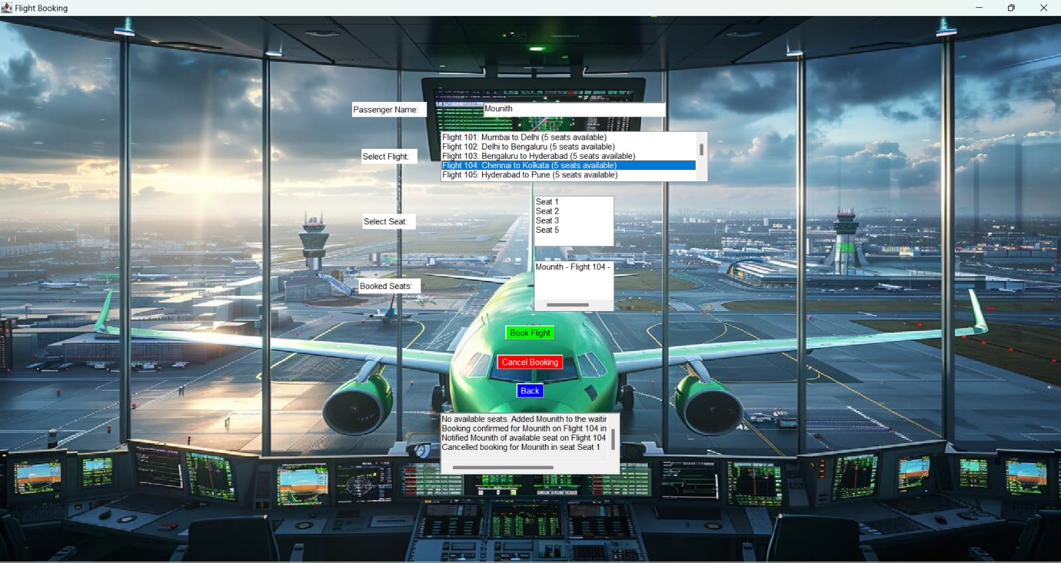
Module 3(Booking And Cancelling)

Slide 11
Thank you!

